Slide 1
Bus-based Fabric
Anuparna Ganguly
18/02/2026

Slide 2
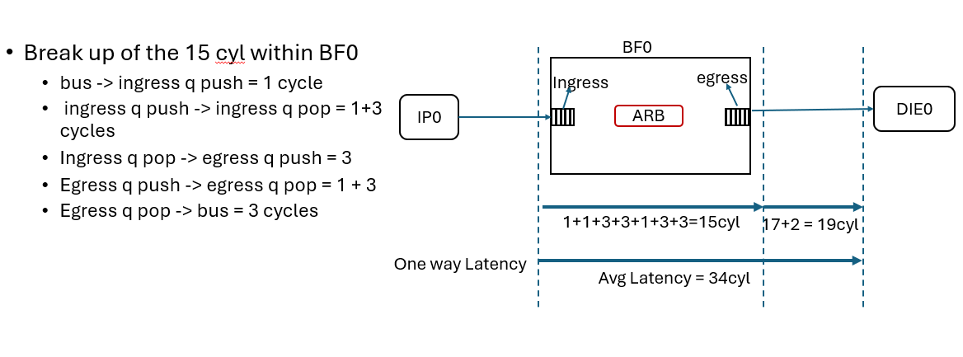
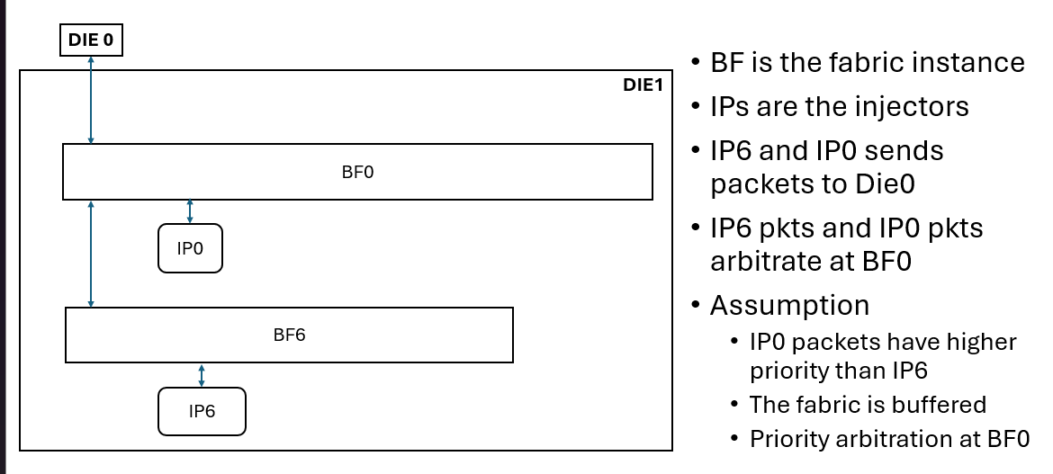
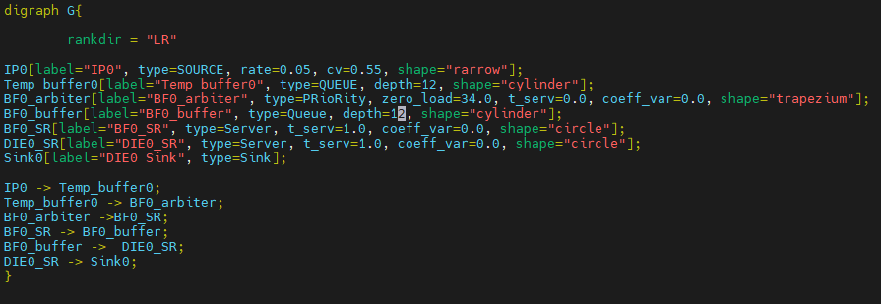

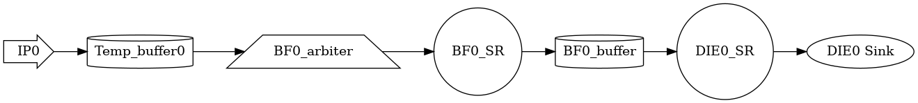
Experiment 1 : IP0->BF0->DIE0; NO IP6
Buffer size = 12
IP6 is inactive and doesn’t send any packets into the fabric
o/p from FlexNoC
../test/busFabricExp1.dot
Autogenerated png file

Slide 3
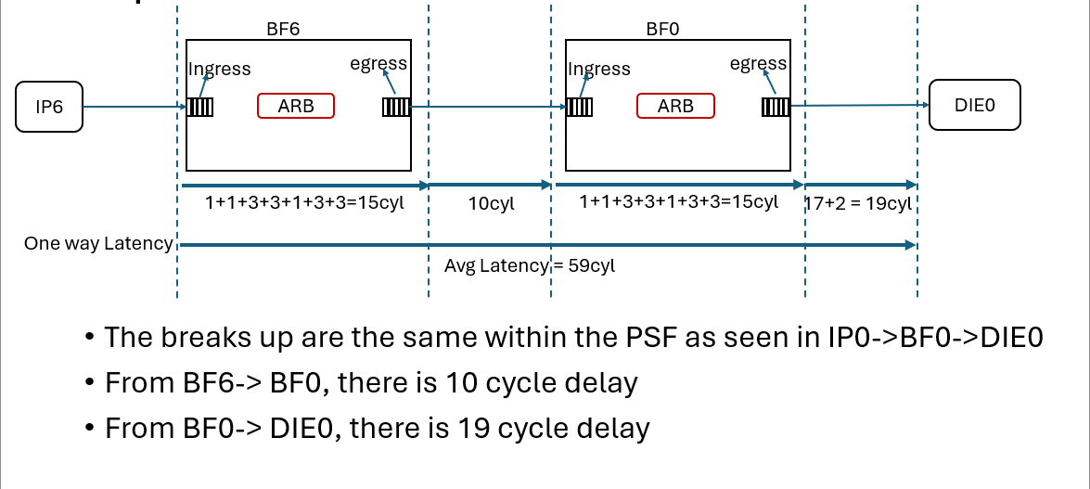
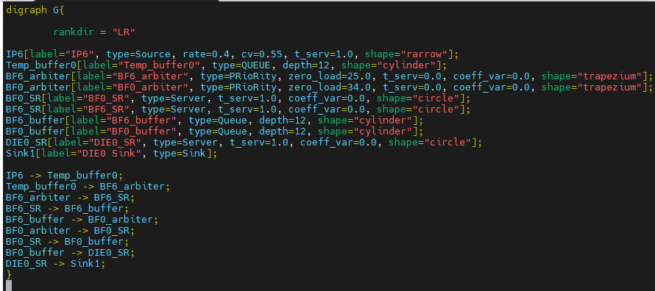

Experiment 2 : IP6->BF6->BF0->DIE0; NO IP0
Buffer size = 12
IP0 is inactive and doesn’t send any packets into the fabric
o/p from FlexNoC
../test/busFabricExp2.dot
Autogenerated png file

Slide 4
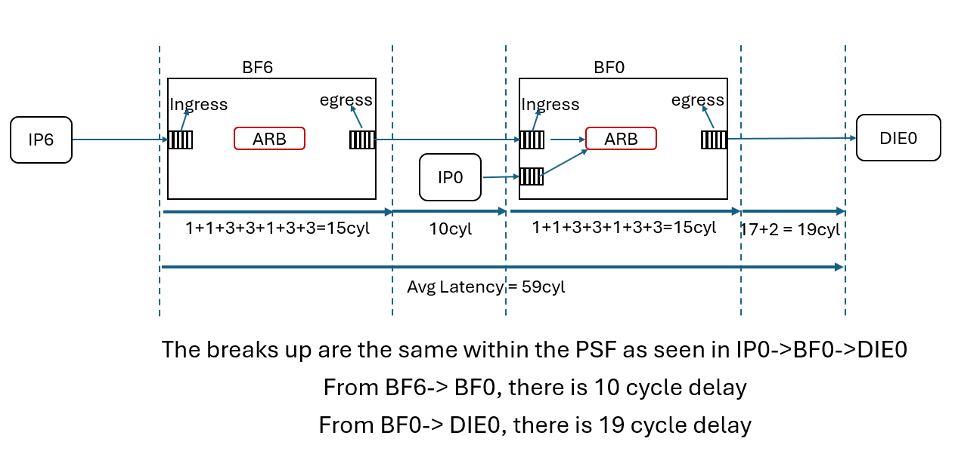
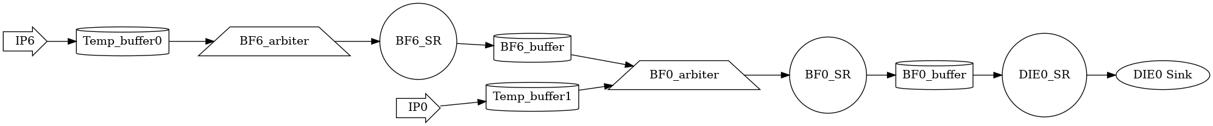
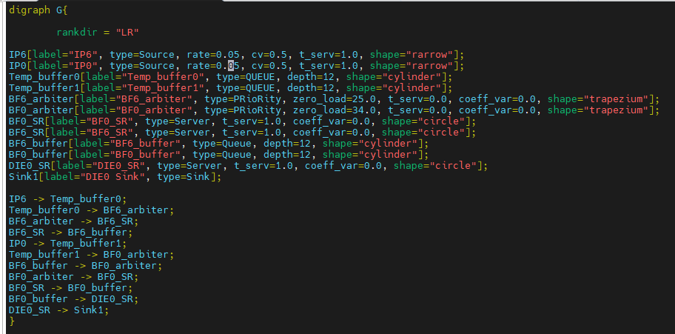
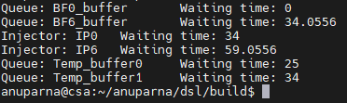
Experiment 3(a): Both IP6 & IP0 has lower injection
Buffer_ size = 12
IP0 has higher priority than IP6.
IP0 ‘s end-to-end latency = queue waiting time + pipeline delay = 0(BF0 -> DIE0) + 34 = 34
IP0’s waiting time 0 as IP0 has high priority, need not to wait.
IP6 ‘s end-to-end latency = queue waiting time + pipeline delay = 0.05 +25(BF6 -> BF0) + 34 (BF0 -> DIE0)= 59.05
../test/busFabricExp3.dot

Slide 5
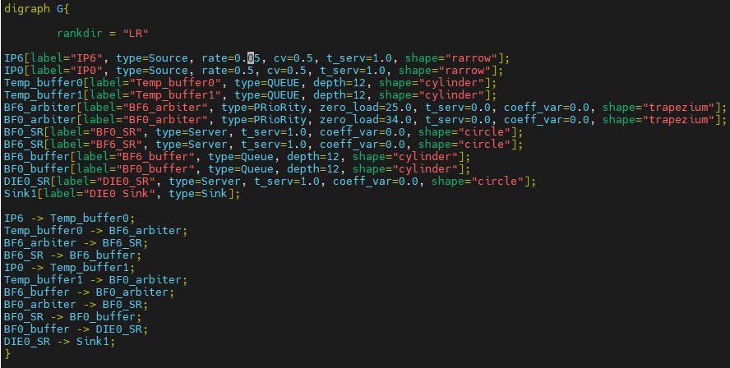
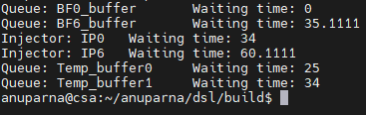
Experiment 3(b): IP6 has lower injection rate & IP0 has high injection rate
Buffer_ size = 12
IP0 has higher priority than IP6.
IP0 ‘s end-to-end latency = queue waiting time + pipeline delay = 0(BF0 -> DIE0) + 34 = 34
IP0’s waiting time 0 as IP0 has high priority, need not to wait.
IP6 ‘s end-to-end latency = queue waiting time + pipeline delay = 1.11 +25(BF6 -> BF0) + 34 (BF0 -> DIE0)= 60.11
../test/busFabricExp3.dot

Slide 6
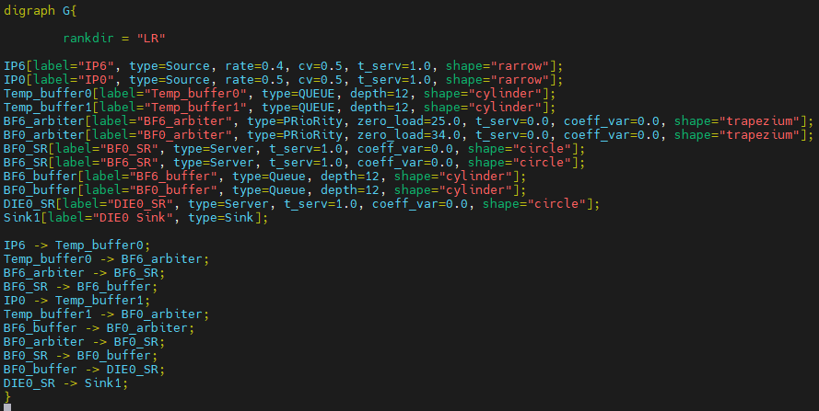
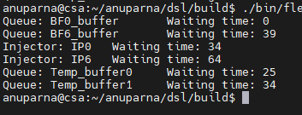
Experiment 3(b): Both IP6 & IP0 has high injection rate
Buffer_ size = 12
IP0 has higher priority than IP6.
IP0 ‘s end-to-end latency = queue waiting time + pipeline delay = 0(BF0 -> DIE0) + 34 = 34
IP0’s waiting time 0 as IP0 has high priority, need not to wait.
IP6 ‘s end-to-end latency = queue waiting time + pipeline delay = 5 +25(BF6 -> BF0) + 34 (BF0 -> DIE0)= 64
../test/busFabricExp3.dot

Slide 7
Back up
BF6
BF0
Ingress
egress
Ingress
egress
IP6
DIE0
ARB
ARB
IP0
1+1+3+3+1+3+3=15cyl
10cyl
1+1+3+3+1+3+3=15cyl
17+2 = 19cyl
Avg Latency = 59cyl

Slide 8
BF6
BF0
Ingress
egress
3+10+1+1+3=18
egress
1
22
IP6
ARB
DIE0
ARB
1 +3
3+1+3
IP0
1
3+1+3
1 +3
1+1+3+3+1+3+3=15cyl
10cyl
1+1+3+3+1+3+3=15cyl
17+2 = 19cyl
Avg Latency = 59cyl

